Slide 1
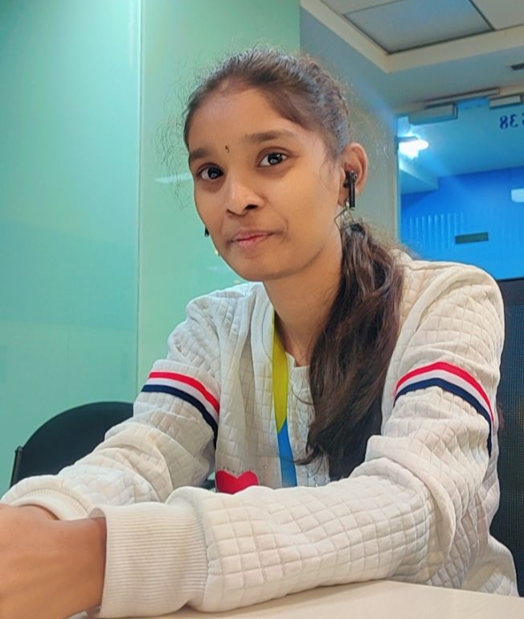


KELLA LAKSHMI SREE
Bachelor of Technology, Electronics and Communications : 2018 – 2022
Completed AZ900 Certification
Completed AZ104 Certification
Completed PL900 Certification
Associate/Software Associate
Bangalore
Skills
Kella.Lakshmi-sree@capgemini.com
+91 9390082224
C# | Basics, OOPS, Exception Handling ,Arrays ,Collection, Generics and Delegates
.NET Framework | ADO.NET,ASP.NET with MVC5 an WEB API, Entity Framework
Database | SQL server
Tools | GIT,POSTMAN, Swagger
UI Technology | HTML5 ,CSS & Angular
SharePoint Online | Sites ,Lists ,Document library
PowerApps | Canvas App, Model-driven App , Automate flows
Add On Skills | Communication Skills, Team Management
A3
Full Stack Developer
Understanding of RDBMS concepts using SQL Server.
Practical understanding of C# and SQL concepts using Visual Studio and SQL Server.
Hands on experience in developing applications using .NET Framework, ADO.NET Core, ASP.NET
Understanding of HTML5 , CSS and Angular CLI
Knowledge on creating Single Web Page Application using Angular
Completed Az-900 course
Online Flight Booking System Video link
Case study of Online Flight Booking System along with API Gateway, Swagger, JWT Based Authentication, responsive UI with HTML5, CSS, Bootstrap and Angular used as User Interface. This application enables a customer to book a flight reservation in advance and can cancel the booking or Check in into the flight and also an admin user can perform various administrative operations like Airport management, Flight Management and Customer management.
Technologies used:
Angular
ASP.NET Core Web API
Microsoft SQL Server
Check out my GitHub Repository

